Slide 1
Introduction to Tableau
Part 6
Notes:
Welcome back to Data Society! We have a great class ahead of us today.

Slide 2
Module completion checklist
Objective | Complete
Discuss formatting options in Tableau
Explain the concept of functions
Implement basic functions on the dataset
Introduction to table calculations

Slide 3
Tableau functions
Tableau’s built-in functions are essential for being able to customize your data representation.
Just as you might need to learn Excel commands and SQL functions, we will need to get familiar with Tableau’s syntax.
For a complete listing of Tableau’s function repertoire, you can have a look at the documentation [link] on the tool’s website.
Notes:
The purpose of this slide is to introduce Tableau’s built-in functions. COMPARE the operations available within Tableau to those you might find in Excel and SQL.

Slide 4
Function types
Tableau functions are classified into several types.
These include:
Number Functions
String Functions
Date Functions
Type Conversion
Logical Functions
Aggregate Functions
Pass-Through Functions (RAWSQL)
User Functions
Table Calculation Functions
Spatial Functions
Additional Functions
To see Tableau functions separated by type, visit this page [link].
Notes:
The purpose of this slide is to introduce the typology of functions native to Tableau. EXPLAIN what some of these function types mean, especially Number Functions and Aggregate Functions (since they’re the next function types you’ll be exploring in detail next).

Slide 5
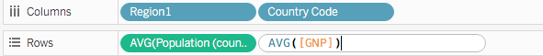
Creating a function: option 1
There are two ways to create functions in Tableau.
Option 1: Specify directly in the “shelf.”
Useful for simple calculations.
This creates data in the view without adding a new column.
Note: You can create a new column by dragging it to the data pane.
Notes:
The purpose of this slide is to demonstrate how to create a function using the shelf. WALK THROUGH how to do so.
Time permitting, you might also WALK THROUGH how to create a new column by dragging the function to the Data pane.

Slide 6
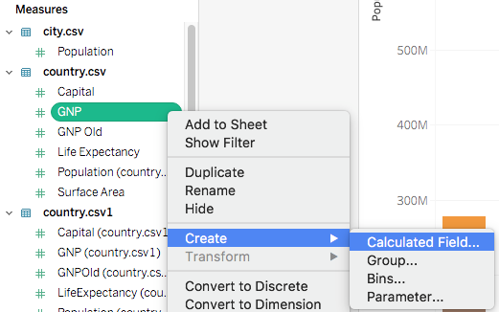
Creating a function: option 2
Option 2: Specify with the menu.
Useful for more complex calculations.
Creates a new column in data.
Notes:
The purpose of this slide is to demonstrate how to create a function using the menu. WALK THROUGH how to do so.

Slide 7
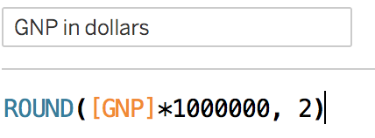
Basic function syntax
Function parts:
Built in functions
control flow (black)
math operations (=,-,/,*...)
logical operators (<, >, =)
math functions (blue)
Fields from data pane (orange)
Strings (demarcated by “ ”)
Integers
Column name
Function arguments
Math operation
Data field
Math operator
Notes:
The purpose of this slide is to explain the basic elements of Tableau function syntax. DEFINE all of the relevant terms onscreen and in the diagram.

Slide 8
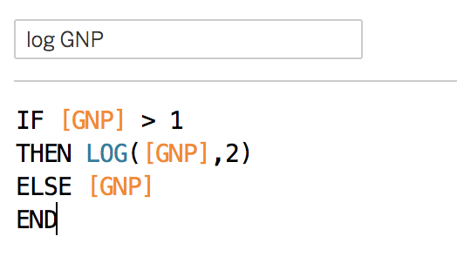
Control flow using function syntax
This is a simple function that gets the log of the GNP data column.
Base 2 log for values > 1.
Otherwise it takes the value.
Column name
control flow elements (black)
data field
(orange)
Math operation (blue)
function END
Notes:
The purpose of this slide is to explain the basic elements of control flow using Tableau function syntax. DEFINE all of the relevant terms onscreen and in the diagram.

Slide 9
Module completion checklist
Objective | Complete
Discuss formatting options in Tableau
Explain the concept of functions
Implement basic functions on the dataset
Introduction to table calculations

Slide 10
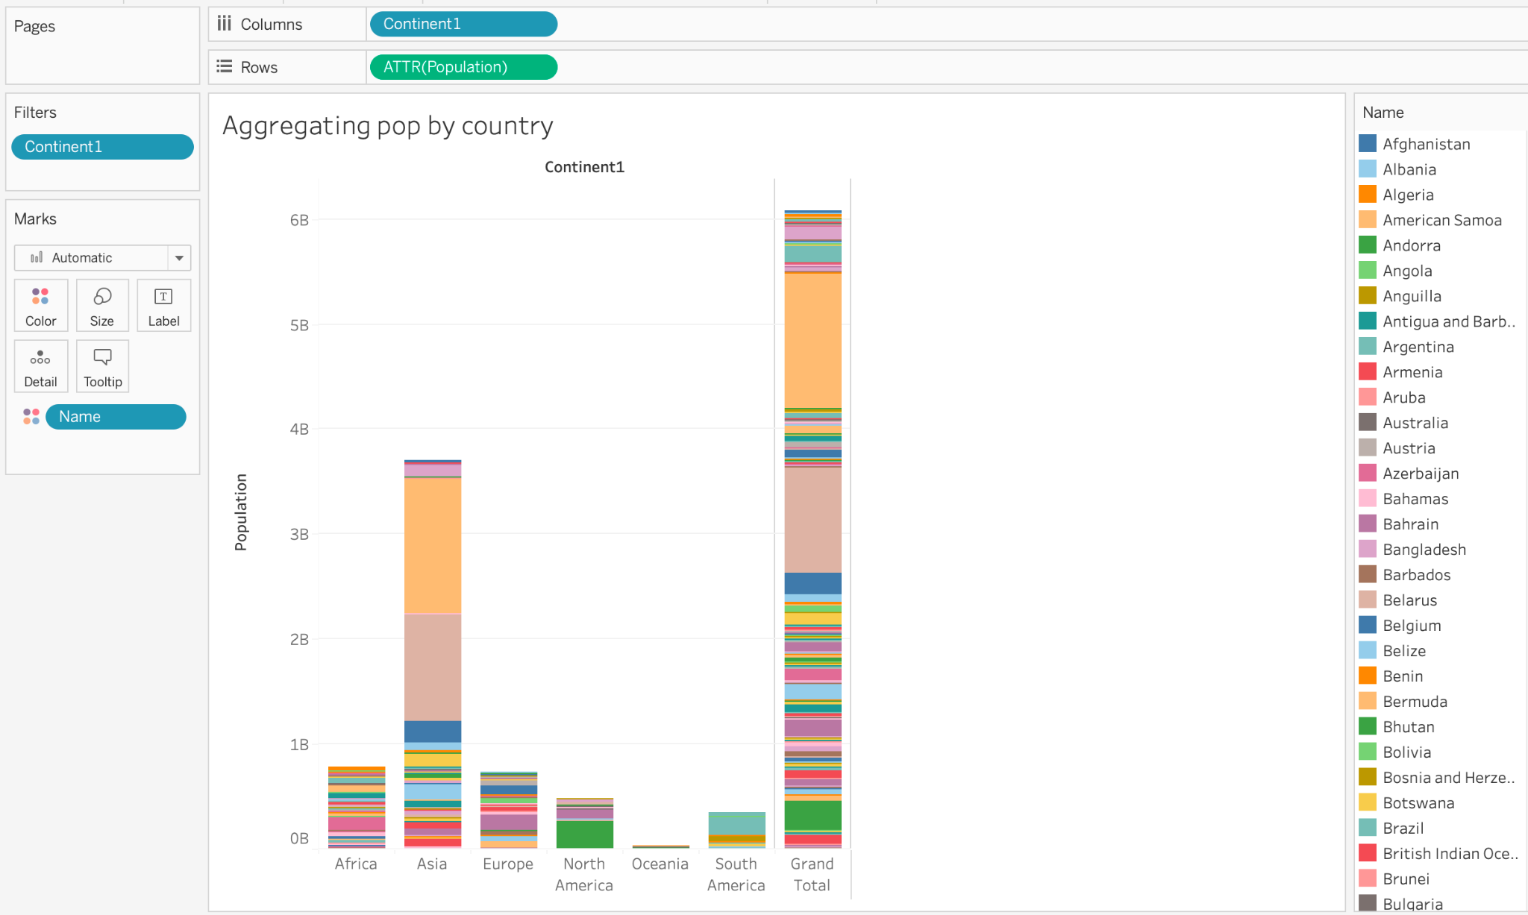
Create a basic population chart
Before creating and implementing our first function, let’s start by creating a continent-level population analysis graph.
Notes:
The purpose of this slide is to create the continent-level population bar graph. We will use this visualization as the basis for implementing our first function.

Slide 11
Creating a function
We will now create our first function in Tableau using GNP.
Right click on the GNP field to get to the calculation pane.
Then select “Create” > “Calculated Field…”
Notes:
The purpose of this slide is to begin walkthrough through how to create a function based on the Population data.

Slide 12
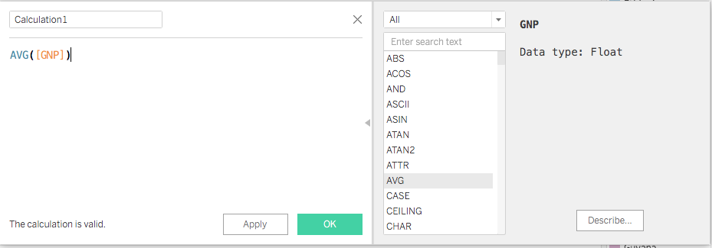
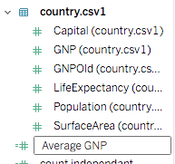
Validating a function
We’re going to calculate the average GNP grouped by country.
Input the formula and note if calculation is “valid,” or properly formatted.
A new column appears in the data pane with a “=” prefix, which tells us that the function is calculated.
Notes:
The purpose of this slide is to DEMONSTRATE the syntax used for the function to calculate the average GNP by country, as well as how to check the validity of an input function.

Slide 13
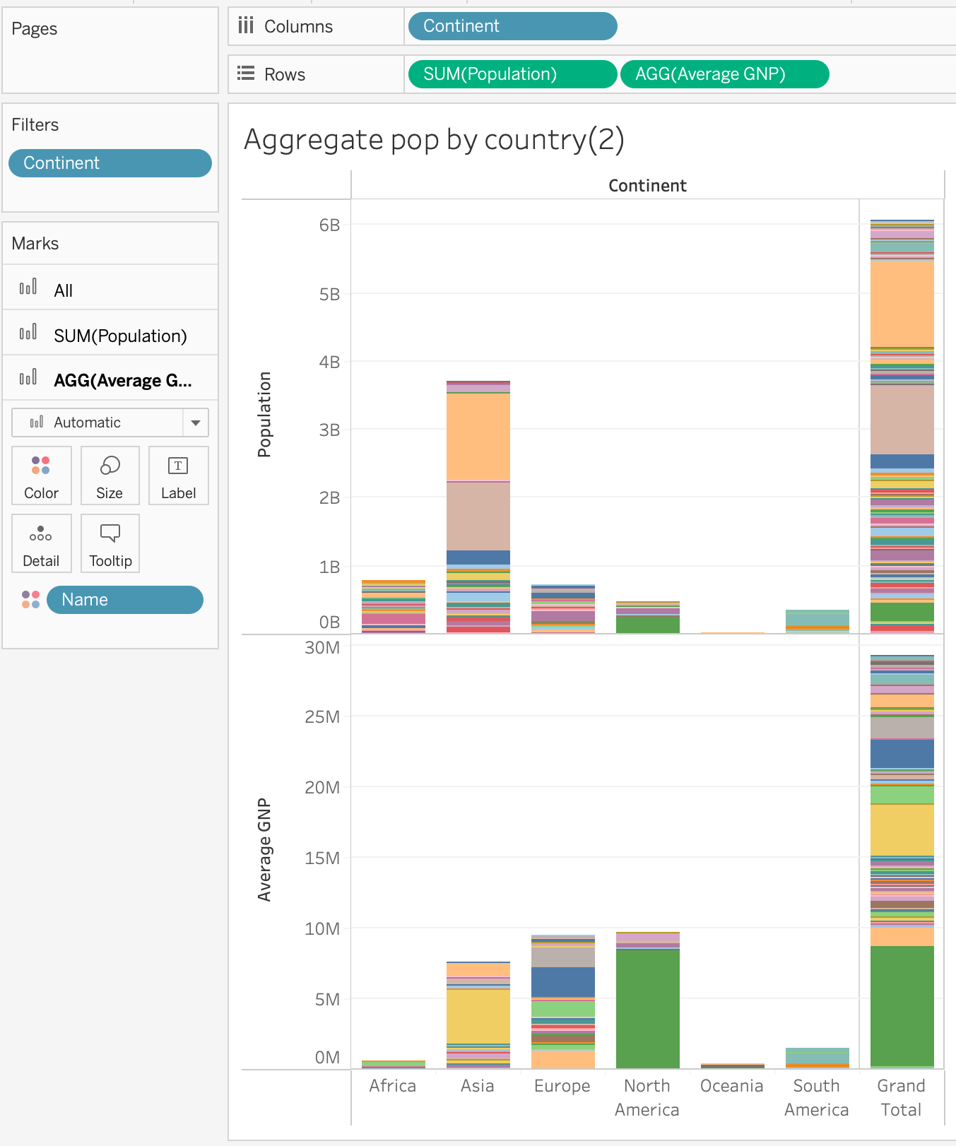
Modifying a visualization via function
Then, drag average GNP to the new field into our analysis shelf (notice it auto aggregates at the continent level!).
Average GNP now appears as a separate pane within our visualization.
Notes:
The purpose of this slide is to implement the average GNP function within a continent-level population bar graph.

Slide 14
Knowledge check 6

Slide 15
Exercise 6

Slide 16
Module completion checklist
Objective | Complete
Discuss formatting options in Tableau
Explain the concept of functions
Implement basic functions on the dataset
Introduction to table calculations

Slide 17
Preview: table calculations
Table calculations give you calculations derived from the view, such as:
Rank
Percentile
Moving average
Difference
Running total
These calculations do not consider any measures or dimensions that are filtered out of the visualization.
Next time, we’ll learn how to implement table calculations on our dataset.
Notes:
The purpose of this slide is to offer a preview of table calculations, which will be discussed in much more detail in the next session.

Slide 18
Module completion checklist
Objective | Complete
Discuss formatting options in Tableau
Explain the concept of functions
Implement basic functions on the dataset
Introduction to table calculations

Slide 19
What we covered today
In the past few modules, we covered:
Formatting figures
Format menu
Right-clicking elements
Marks card
Annotations
Tableau functions
Basic function syntax
Creating a function via shelf
Creating a function via menu
Implementing a function
Introduction to table calculations
Notes:
The purpose of this slide is to review the various topics covered in class today. It is also an opportunity to ASK if students have any outstanding questions that need to be resolved.

Slide 20
Next steps
In the next few modules, we will cover:
Functions
Table calculations
Level of detail (LOD) functions
Number functions
Aggregate calculations
Until then, stay excited!
Notes:
The purpose of this slide is to introduce the agenda for the next session. COMMENT briefly on each topic to set expectations and encourage prediction.

Slide 21
End of Part 6

